Slide 1
OLAVE
“The 2019 event”

Slide 2
2019
THE OLAVE PEARL

Slide 3
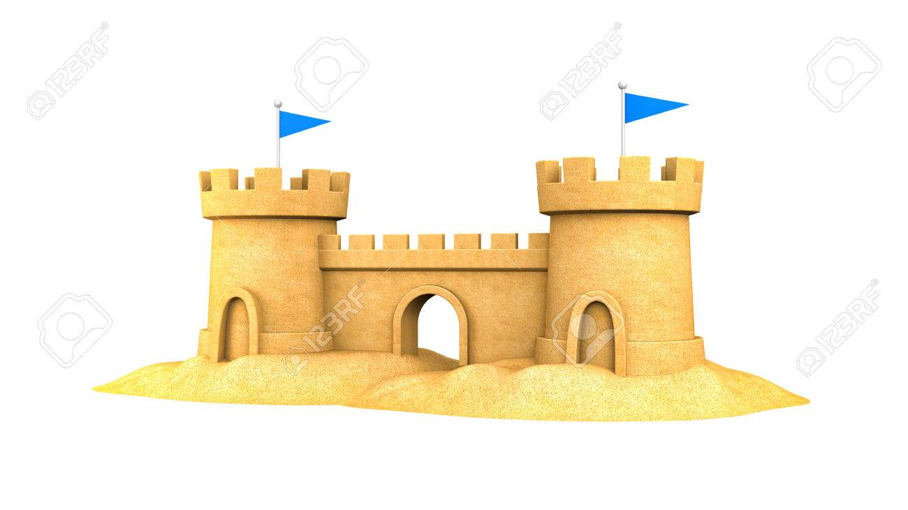
The first County international Olave camp took place at Battle Abbey in 1989
- 30 years ago!
30 years is a Pearl celebration, that’s where we got our ideas from…..

Slide 4
Girls and women from that first camp
are still involved in Guiding today
and will be there at the 2019 camp!
They will be our Olave Pearls

Slide 5
An overview of the plans for the Programme
We want our Pearl anniversary camp to be a celebration of our County
SUSSEX BY THE SEA!!

Slide 6
Sat | Sun | Mon | Tue | Wed | Thur | Fri | Sat
Opening ceremony | Get on board | Voyages of Discovery | Open day | Ocean Commotion | Voyages of Discovery | Treasure Island | Strike
 | Treasure island | The Coral Reef |  | Get on board | The Coral Reef | Ocean Commotion
 | Ocean Commotion | The Senior Section |  | Treasure Island | The Senior Section | Get on board
Sunday Wednesday Friday = 3 day rota
Monday & Thursday = 2 day rota

Slide 7
Here’s a sneak preview of the plans and activities
so far for the zones………

Slide 8
Zone summary
A relaxing ‘Holi’-day on site
Late risers will love it – you get a lie in!
Slow stroll to the activities which may include:
Pamper zone, yoga, nails, mani/pedi, hair treats, etc
Dip in a skip
Sandcastles
Punch & Judy
Crafts
A book/comic swap area
And lots more to relax you!!!
The
Coral reef
Team Leader
Coral Carpenter
(get it?!)

Slide 9
Zone summary
An exciting trip out to one of our local places of interest:
Hastings (via Battle/Bodiam)
Brighton (via Lewes)
Take a walk down Olave memory lane at Battle Abbey, visit some famous Sussex castles, pop into a local Sea-Life centre and spend some time on a seaside activity or 2!
And maybe grab some
Voyages
Of
Discovery
Team Leader
Pam Colegrave

Slide 10
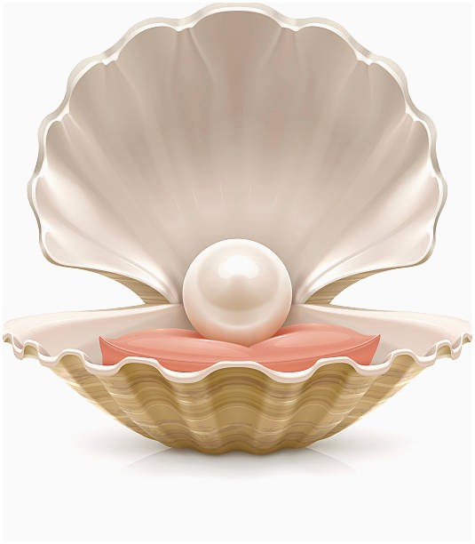
Zone summary
Challenges in and around sub-camps about people, places and things – including finding those elusive Olave pearls
(Leaders may be subjected to searches!)
All completed challenge booklets will receive an exclusive badge
The Pearl Quest
Team Leader
Wendy Clegg

Slide 11
Zone summary
Opportunity to try some of the favourite Blackland farm on-site activities, including:
Crate challenge
Climbing wall
Leap of faith
Bungee trampolines
Swimming
And to learn some new skills too – swoove, hula hoops, BSL, drumming, whittling, golf, and more!
Get on
Board
Team Leaders
Lynnie Hutchison
& Karen Clarke

Slide 12
Zone summary
A great opportunity to explore all things in, on, under and over the ocean:
Fish, shells and creatures
How the water works
Caring for the seas
Plant life
Have a go at sailing!
And learn about the environment, encouraging on-site recycling – and proving our efforts!
Ocean
Commotion
Team Leader
Tori Lansley

Slide 13
Zone summary
An on-site away day
There will be pirates,
and mermaids,
and challenges,
and treasure,
and treasure maps,
and fires,
and planks,
and glitter!!!
and more……………
Treasure
Island
Team Leader
Gemma Murphy

Slide 14
Zone summary
Activities taking place in the evenings may include:
Olave’s got talent
Craft
Badge swapping
A hair salon (well, sort of!)
Time to relax with friends
A disco
A campfire
And more!!!
Sunset
and
Stars
Team Leader
Tracy Harper

Slide 15
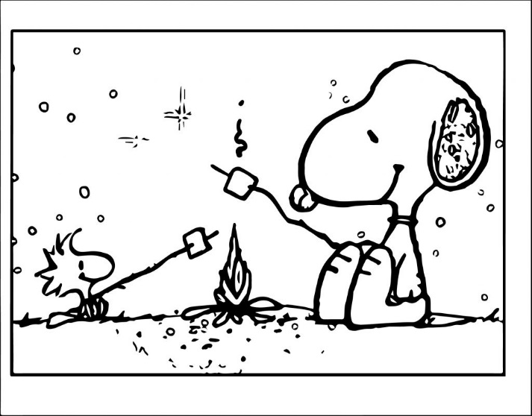
Zone summary
The day all our County friends join us!
Activities may include:
Battle re-enactments,
Birds of prey
Caving bus
Arena displays
A large-scale fundraising event
And plenty for everyone!!!
Open
Day
Team Leaders
Jo Jeffries &
Teri Galpin

Slide 16
Zone summary
Opportunities for SS to have their own activities which might include:
A service project;
A high adventure;
A driving experience;
An away night;
A special event.
But to still take part in the main camp programme where they wish!
Senior Section
Team Leaders
Bex Robins &
Caroline Dyer

Slide 17
And finally……
The Programme plans are not finalised – if you have a burning wish for something to be included, please let us know and we’ll try!
There are also opportunities to join the teams running the zones. If you have people in your Divisions who want to come but don’t have a role, we would be able to find them a spot! Contact Pauline to register interests, and to specify which zone they may be interested in. They don’t even have to stay for the whole week!
Thank you.
Bev Boakes, Olave Programme Team Manager.

